Slide 1
Convolutional Networks
Week 11

Slide 2
Recall
Designing deepforward networks (deep neural networks)
Training them
Today: A special deepforward networks

Slide 3
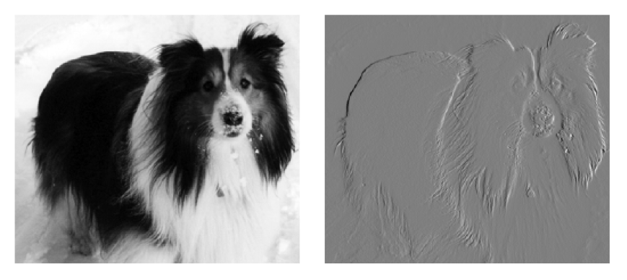
Image Recognition
320 x 280 pixels
Simple operation
Subtract left pixel
How have we done that?
Better way?

Slide 4

Convolution and Cross-correlation
$$s\left(t\right)=∫x\left(τ\right)h\left(t−τ\right)dτ=x\left(t\right)∗h(t)$$
$$s\left(n\right)=∑x\left(τ\right)h\left(n−τ\right)dτ=x\left(n\right)∗h(n)$$
Cross-correlation
$$s\left(n\right)=∑x\left(τ\right)h\left(n+τ\right)dτ=x\left(n\right)∗h(n)$$

Slide 5
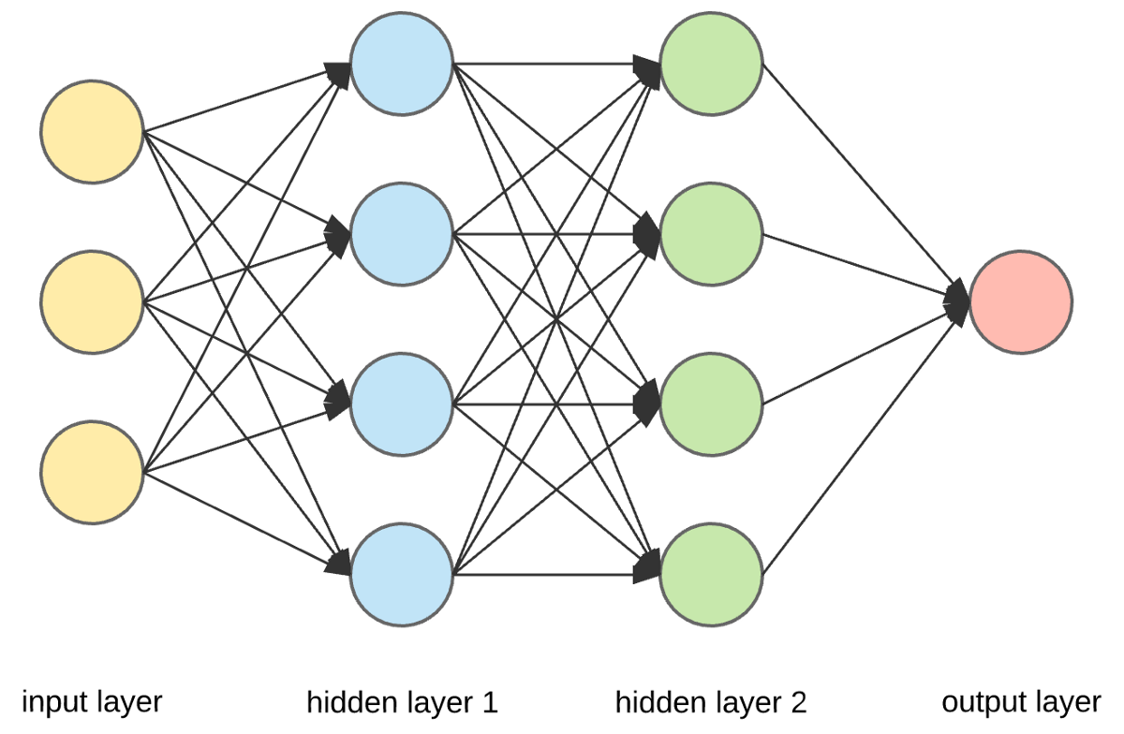
Convolutional Neural Network (CNN)
At least one layer performs convolution
Benefits
Sparse interactions
Parameter sharing
Equivariance

Slide 6
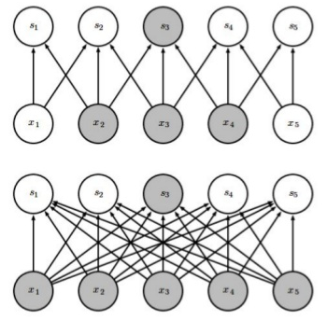
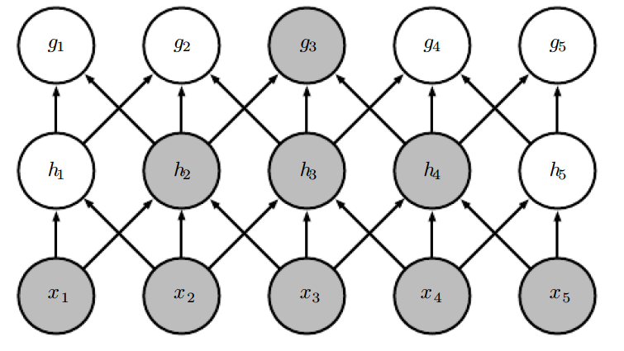
Sparse Representation

Slide 7
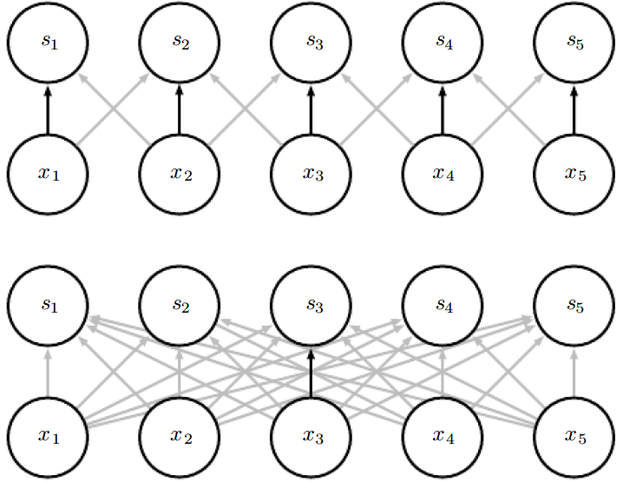
Parameter Sharing

Slide 8
Equivalence
Help in recognizing translations
What does that mean?
Can you think where it would be useful?

Slide 9
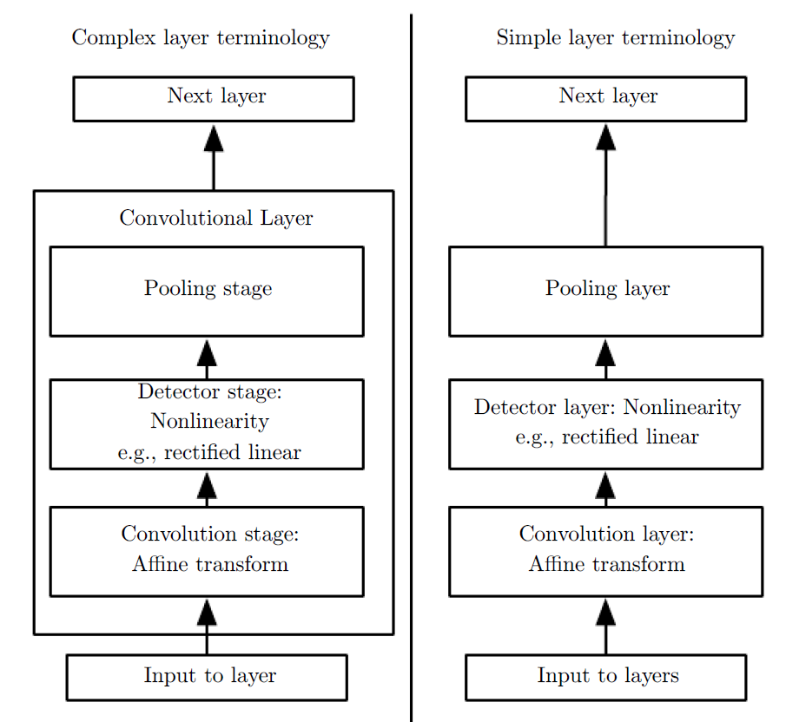
Implementation

Slide 10
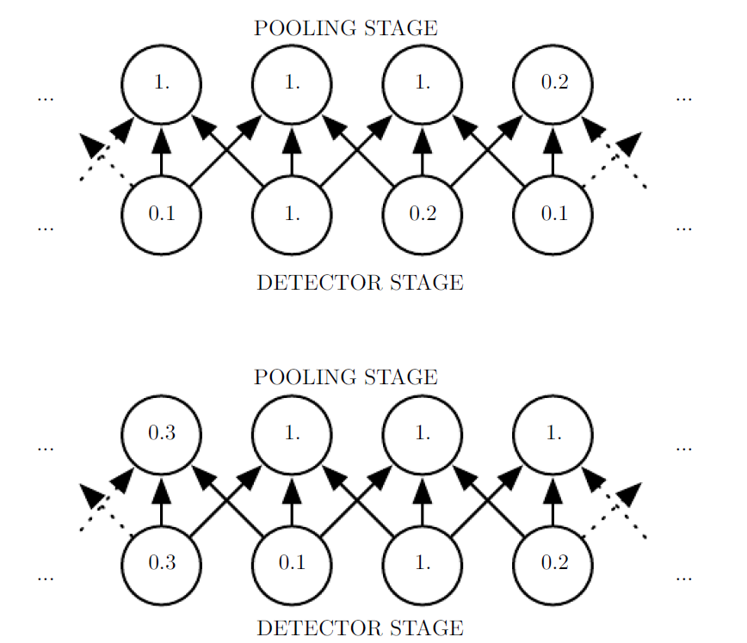
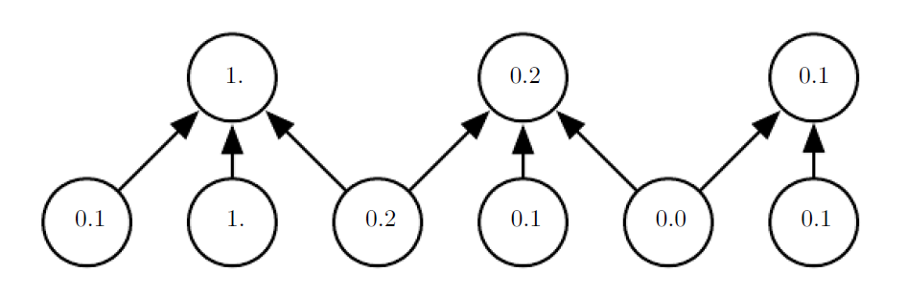
Pooling

Slide 11
CNNs: When are they good?
Grid-like pattern
Inspired by biological visual processing
Introducing assumptions
Things can go horribly wrong if assumptions wrong

Slide 12
Recap
Special kind of DFNs: CNNs
Very powerful but careful in usage
Implementation in tutorial
Do post-class activities
Also pre-class activities for next week

